Slide 1

E-Retail factors for customer activation and retention
Submitted by:
ANKIT DADARWALA

Slide 2
INTRODUCTION
Problem Statement:
Customer satisfaction has emerged as one of the most important factors that guarantee the success of online store; it has been posited as a key stimulant of purchase, repurchase intentions and customer loyalty. A comprehensive review of the literature, theories and models have been carried out to propose the models for customer activation and customer retention. Five major factors that contributed to the success of an e-commerce store have been identified as: service quality, system quality, information quality, trust and net benefit. The research furthermore investigated the factors that influence the online customers repeat purchase intention. The combination of both utilitarian value and hedonistic values are needed to affect the repeat purchase intention (loyalty) positively. The data is collected from the Indian online shoppers. Results indicate the e-retail success factors, which are very much critical for customer satisfaction.

Slide 3
Goal of problem statement
Conceptual Background of the Domain Problem
E commerce is one of the biggest market in today’s era, but it was not the same before some years, Before some years ago Online markets have to struggle to retain or activate the customer’s account, because customers were not ready to trust online things, they are afraid of getting cheated or not exact products received which they have seen in the photo also they are afraid of Money fraud as any online business requires the bank details and confidential information, so due to this customers are not ready to go with the online business rather than they prefer market shopping to feel the product and decrease the fear of fraudulent
But since last 2 to 3 years e commerce has drastically changed and made many changes related to the fear of the customers, E retailers have started to examine the products personally where the customers can able to see assured products due to this different products problems can reduced, also they are giving exchange option so that if the products were not good customers can exchanged, extra security for payment transaction Accordingly there are many advanced level changes were made to retain a customers and motivate new customers to activate their account.
Though the e commerce has now been in the peak level we have some benefits and drawbacks as given below:

Slide 4
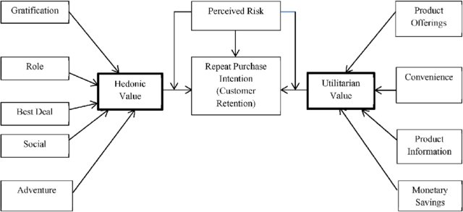
Analytical Problem Framing
What is Utilitarian Value?
Utilitarian value can be called as functional value and it associated with functional benefits of the products, Ex. Suppose someone buy Car and, in this product, utilitarian value is functions of car that satisfied consumers’ need like go one place to another place.
What is Hedonic Value?
Hedonic values define as immediate psychological gratification that comes from consumption of product. The value received is derived from an emotion and actual experience associated with consumption, Ex. Suppose that Person who buy car that give Happiness or feel good in gratification in mind.
.

Slide 5
Analytical Problem Framing
Data Preprocessing Done:
df.columns =df.columns.str.strip() using this code modify the features so that remove extra spaces and commas from features name,Split data into X and Y in that X have all Input features and Y have target feature that include How u approach other persons to use e-retailer for shoppingThen use Ordinal encoders for target columns and Label encoders for Target columns
Use MINMAX Scaler is one of the simplest scalers to understand. It just scales all the data between 0 and 1. FORMULA: x_ scaled = (x – x_ min)/ (x_ max – x_ min)

Slide 6
Data Inputs- Logic- Output Relationships
Feature Selection Methods:
Univariate Selection
Feature Importance
Correlation Matrix with Heatmap
We use Univariate selection as Chi Square test for X input feature selection
What is Chi-square Test?
Chi-square formula is used to compare two or more statistical data sets. The chi-square formula is used in data that consist of variables distributed across various categories and helps us to know whether that distribution is different from what one would expect by chance. The chi-squared test checks the difference between the observed value and the expected value. Chi-Square shows or in a way check the relationship between two categorical variables which can be can be calculated by using the given observed frequency and expected frequency.

Slide 7
The Chi-Square is denoted by χ2. The chi-square formula is:
χ2 = ∑(Oi – Ei)2/Ei
were
Oi = observed value (actual value)
Ei = expected value.
The Chi-Square test gives a P-value to help you know the correlation if any!A hypothesis is in consideration, that a given condition or statement might be true, which we can test later. For example
A very small Chi-Square test statistic indicates that the collected data matches the expected data extremely well.
A very large Chi-Square test statistic indicates that the data does not match very well. If the chi-square value is large, the null hypothesis is rejected.
Chi-Square test statistic is called P-value. The P-value is short for probability value. It defines the probability of getting a result that is either the same or more extreme than the other actual observations. The P-value represents the probability of occurrence of the given event. The P-value is used as an alternative to the rejection point to provide the least significance for which the null hypothesis would be rejected. The smaller the P-value, the stronger is the evidence in favour of the alternative hypothesis given observed frequency and expected frequency.

Slide 8
Application Of Chi Square Test:
used by Biologists to determine if there is a significant association between the two variables, such as the association between two species in a community.
used by Genetic analysts to interpret the numbers in various phenotypic classes.
used in various statistical procedures to help to decide if to hold onto or reject the hypothesis.
used in the medical literature to compare the incidence of the same characteristics in two or more groups.
P-value | Description | Hypothesis Interpretation
P-value ≤ 0.05 | It indicates the null hypothesis is very unlikely. | Rejected
P-value > 0.05 | It indicates the null hypothesis is very likely. | Accepted or it “fails to reject”.
P-value > 0.05 | The P-value is near the cut-off. It is considered as marginal | The hypothesis needs more attention.

Slide 9
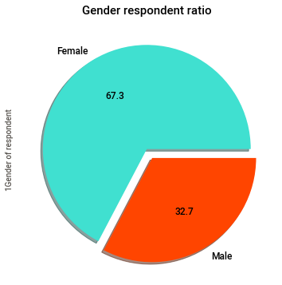
Visualizations
Count plot , Bar plot, Pie plot
Above graph we can say that Female ratio is more than male in online shopping. 67% female to 33% male.

Slide 10
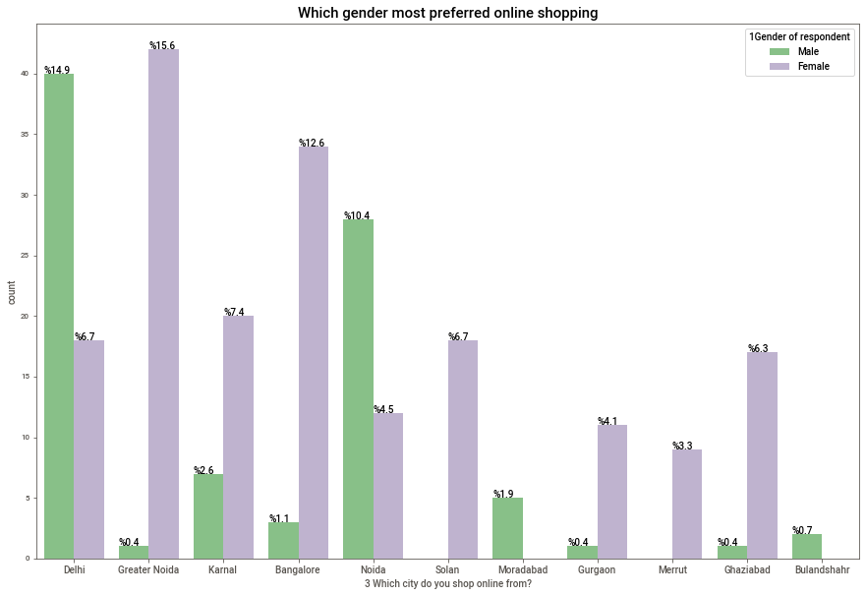
Visualizations
From above plot in Delhi and Noida Online purchases by men is more than female respectively to 15% and 10% we say that men are more interested than women in online shopping or say that it can also save time of shopping in working professional.
Rather than Delhi and Noida other cities women ratio are more in online shopping highest shopping count in Greater Noida 15.6%.
In other cities also women ratio is high in online purchases as they getting sufficient time and getting all thing at one place with benefits.
In Moradabad and Bulandshahr only males are interested for online shopping.
In Merrut only females are responding for online shopping.
Also, Cities like Delhi, Grater Noida, Bangalore, Noida highest rate of online shopping users.

Slide 11
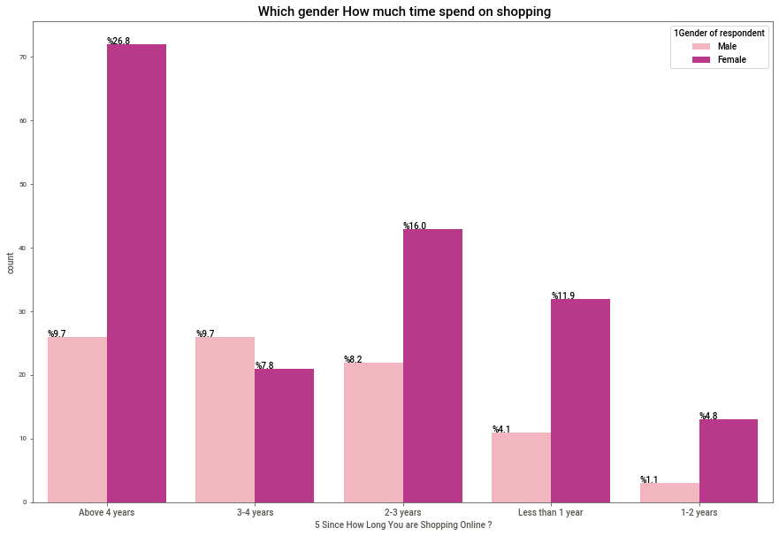
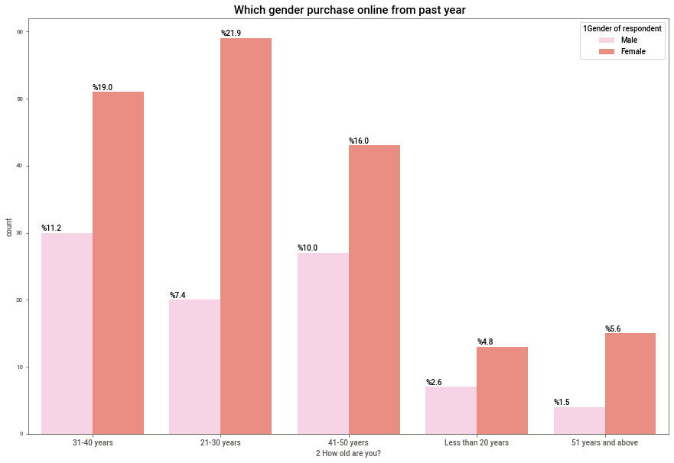
Most of female are spending time on online shopping
21 to 50 year's people in that mostly female are preferred online shopping

Slide 12
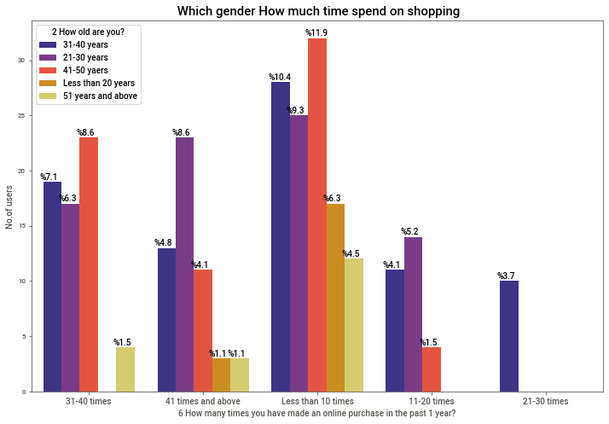
More than 40 min time spend on shopping websites are youth generation age between 21-30 years
Age of 41-50 years mostly spend time of less than 10 min for chech best deals or offers on perticulat product or 30-40 min of day on while during shopping.

Slide 13
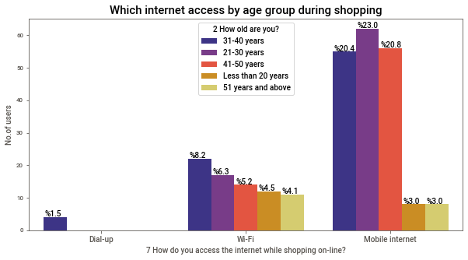
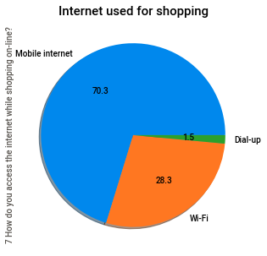
Most of people use Mobile internet for online shopping about to 70%
Rest of people use Wi-Fi 28%
very few people use Dial-up mode which very old technique for internet.
Mostly mobile internet used by young as well middle age generation during shopping because of that they can do shopping at any time or any place
Wi-Fi used is less because of they can only access while Wi-Fi is available at that place so it may be office place or home place or any public place

Slide 14
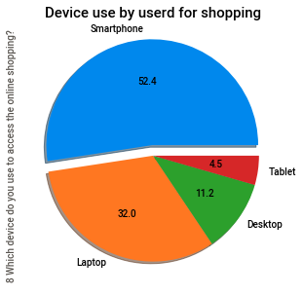
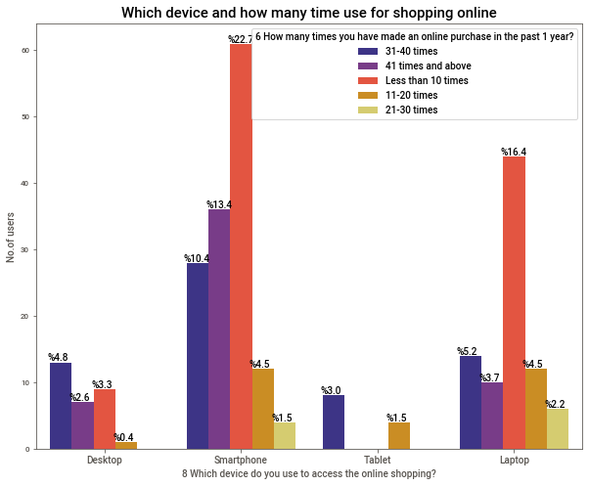
As mobile internet used most from that Smartphone app or websites use most for shopping
As well as Laptop and Desktop also preferred by users for better wide screening options.
In smart phone mostly android/iOS and in Laptop window O/S used.

Slide 15
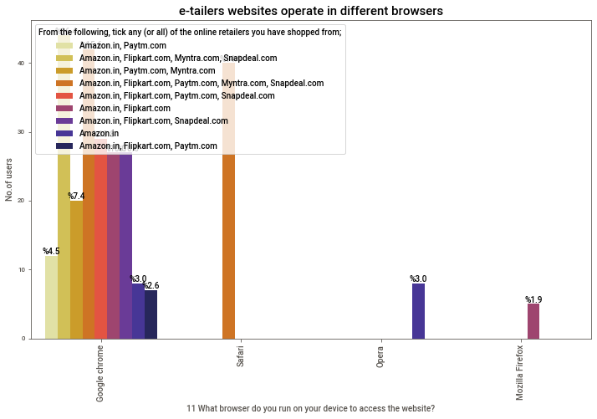
All websites open in google chrome and safari so that mostly preferable
In opera browser only Amazon.in support or say that other website can't take load
Same as Mozilla Firefox Amazon.in, Flipkart.com are supported or both site take less load for opening.

Slide 16
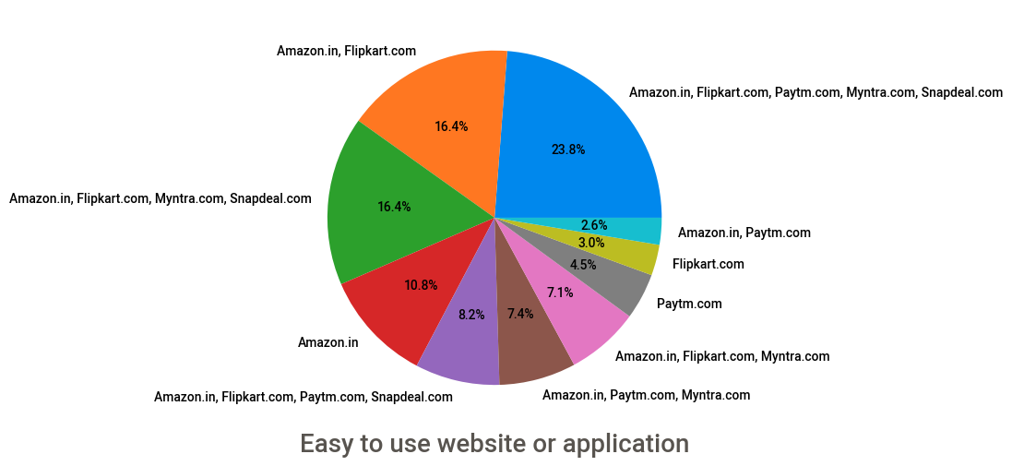
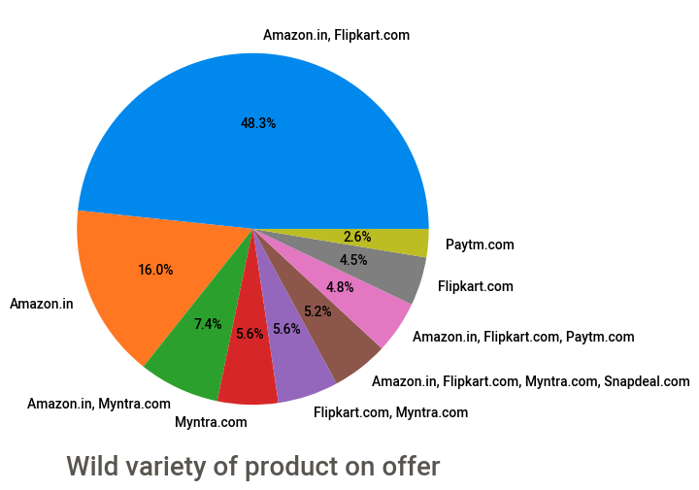
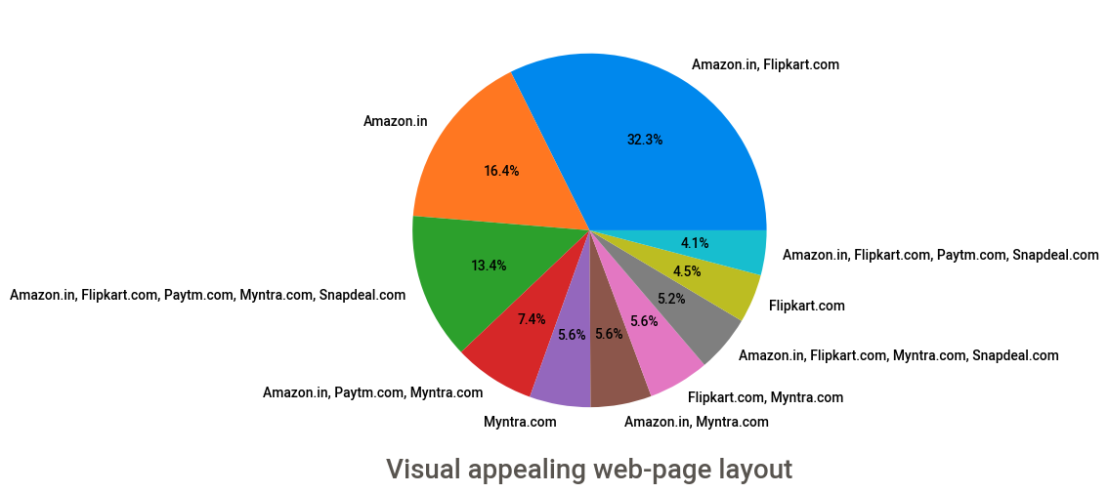
Different E-Retailers Performances

Slide 17
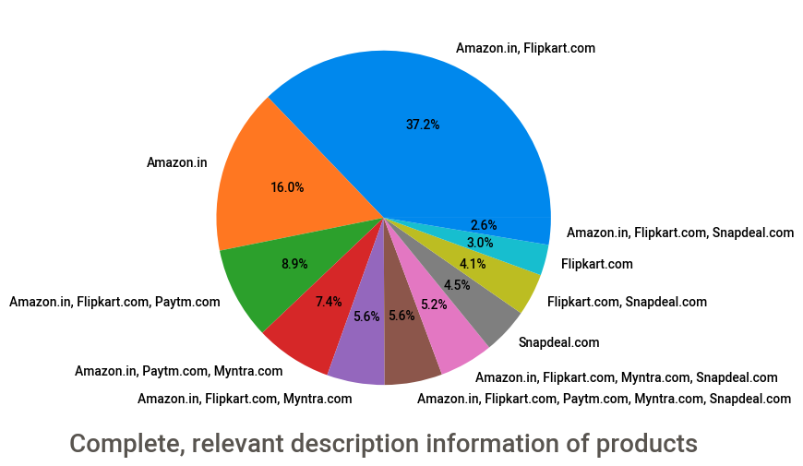
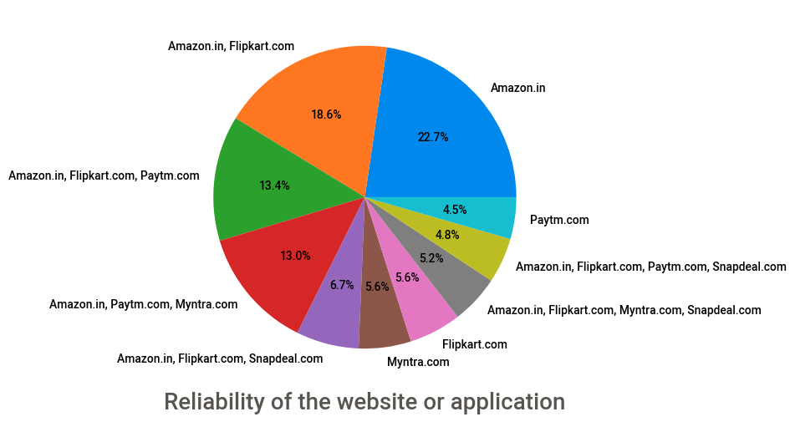
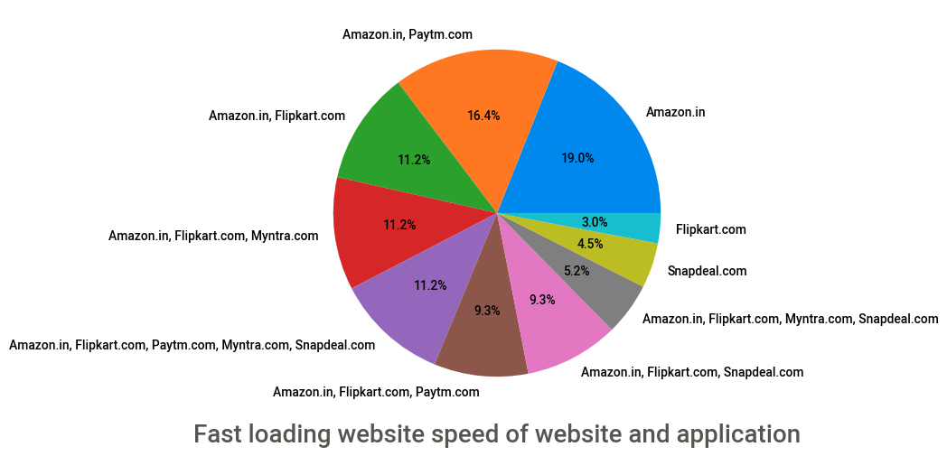
Different E-Retailers Performances

Slide 18
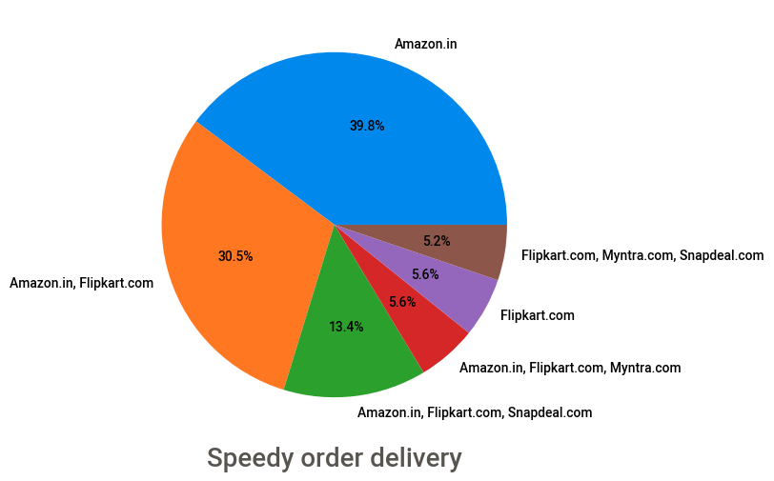
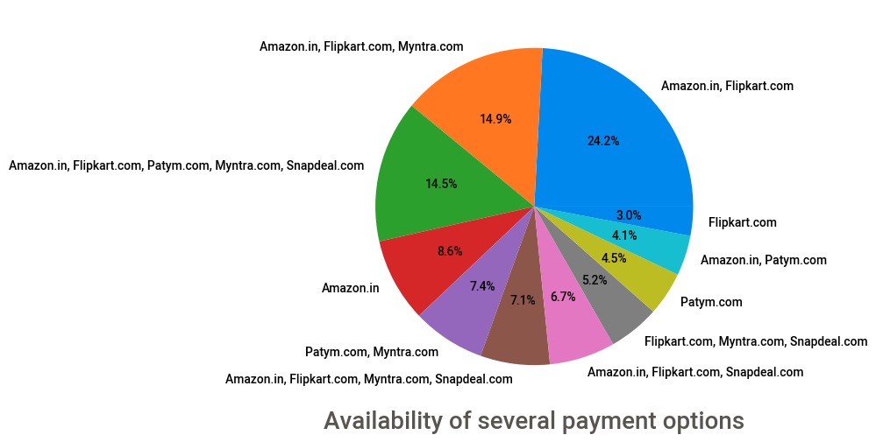
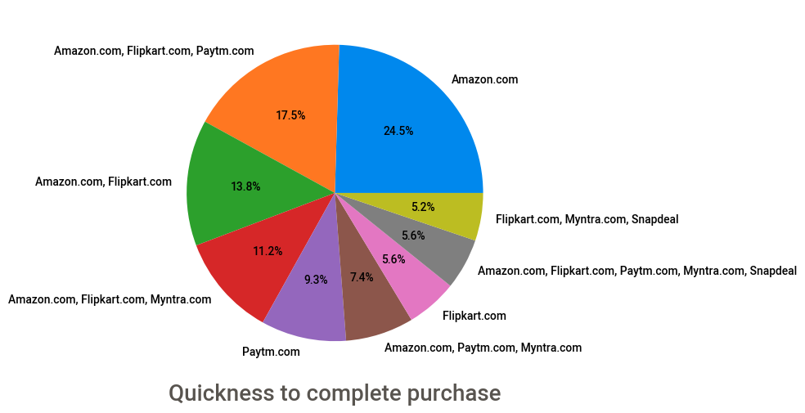
Different E-Retailers Performances

Slide 19
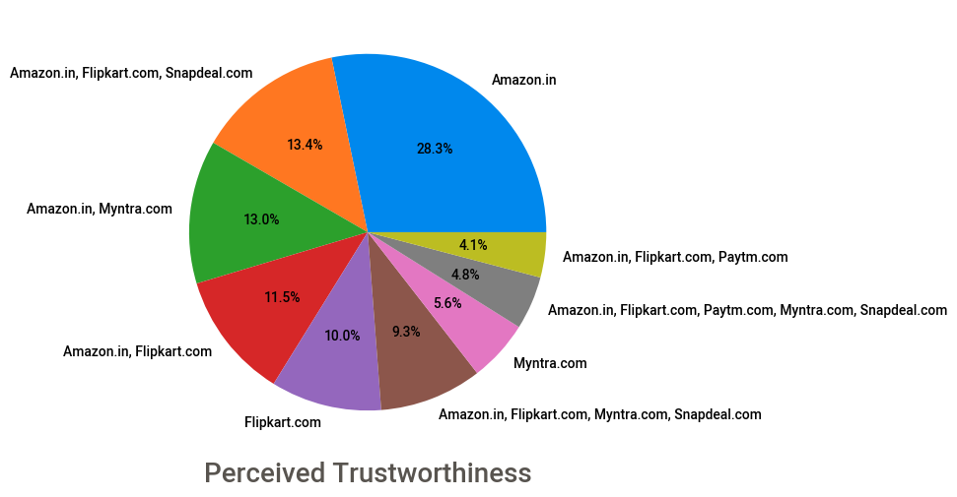
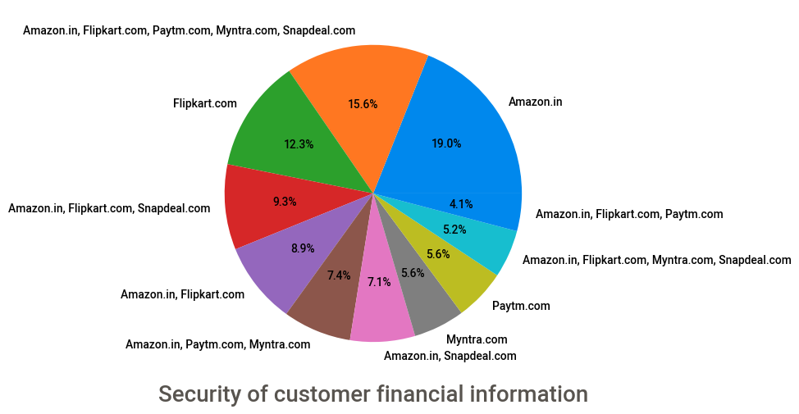
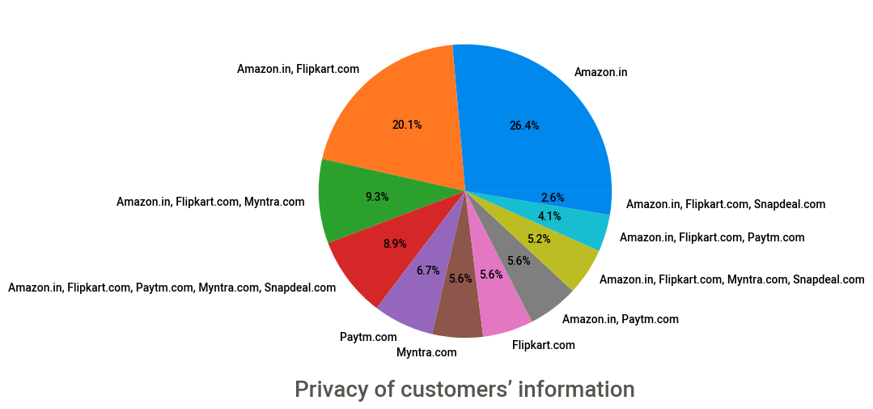
Different E-Retailers Performances

Slide 20
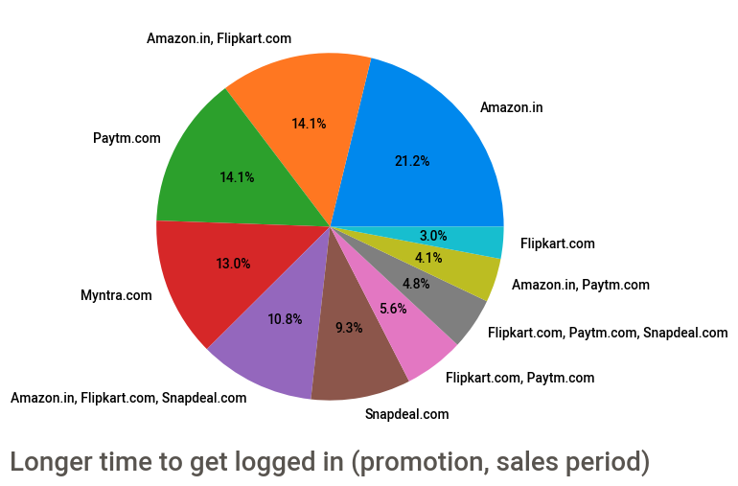
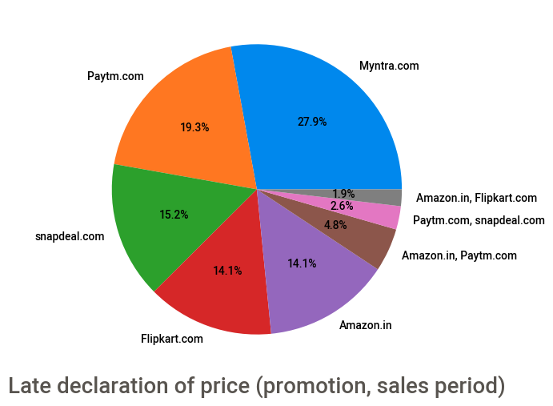
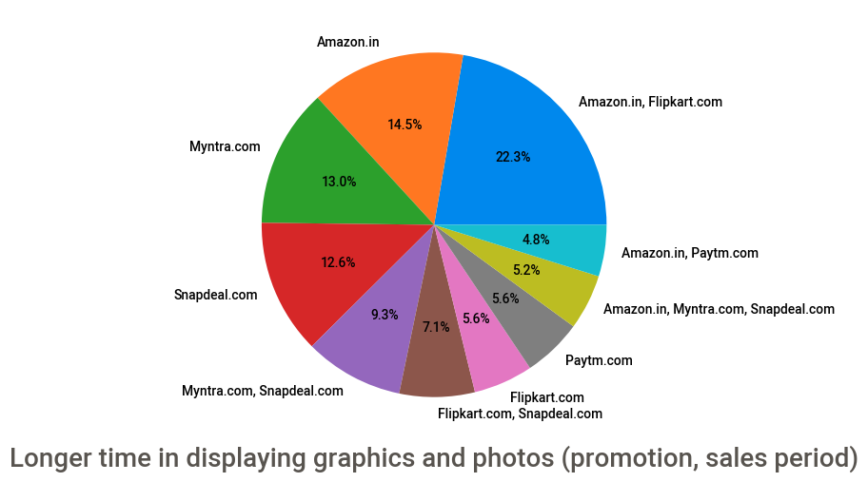
Different E-Retailers Performances

Slide 21
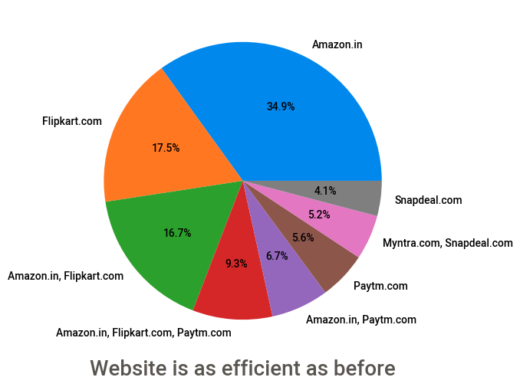
Different E-Retailers Performances

Slide 22
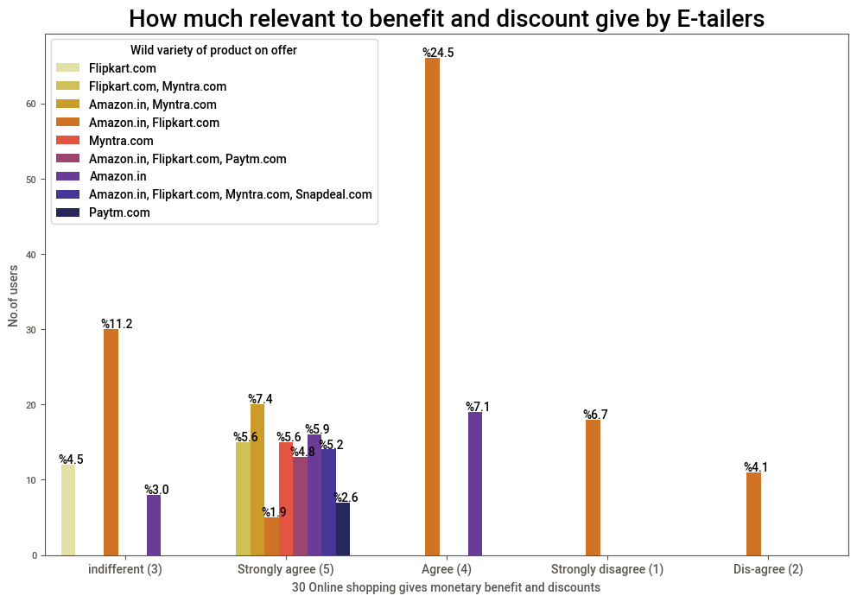
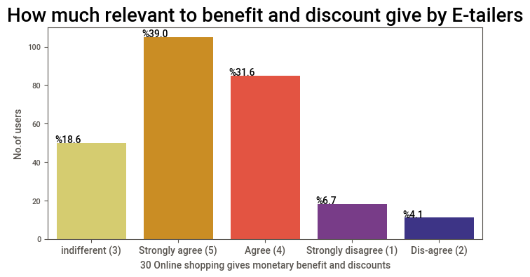
Benefits give by E-Retailers to How much Relevant

Slide 23
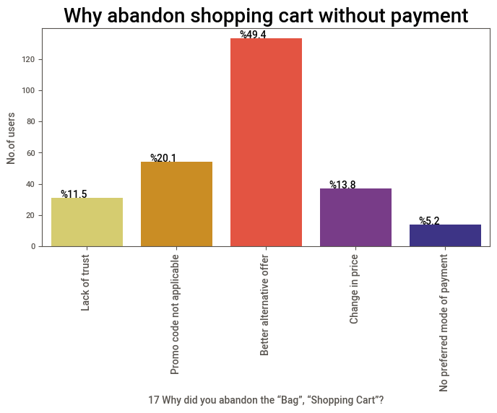
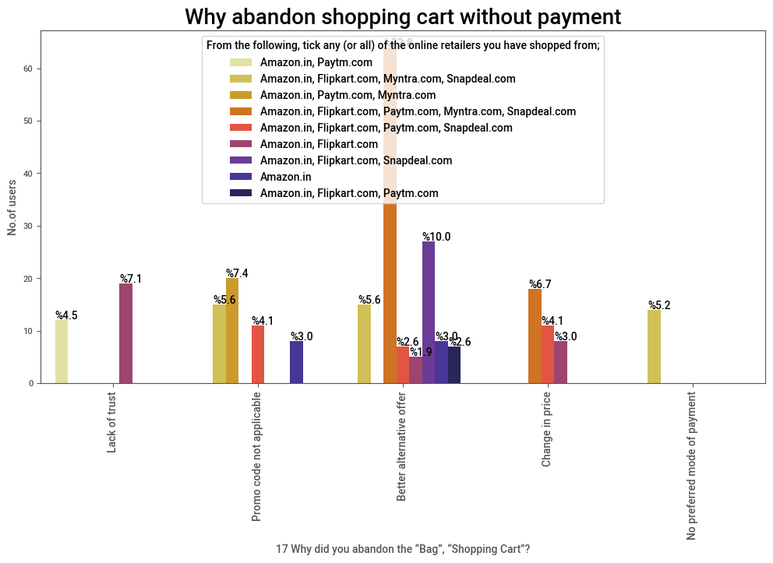
Reason of Abaddon shopping without payment ,Which E-retail website have more Abaddon problems

Slide 24
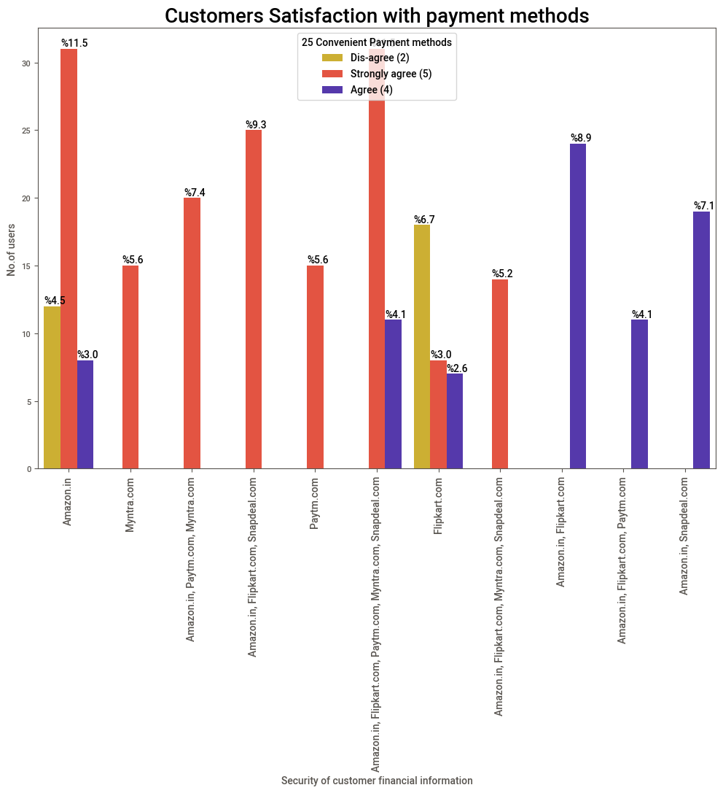
Which Payment method relevant to customers

Slide 25
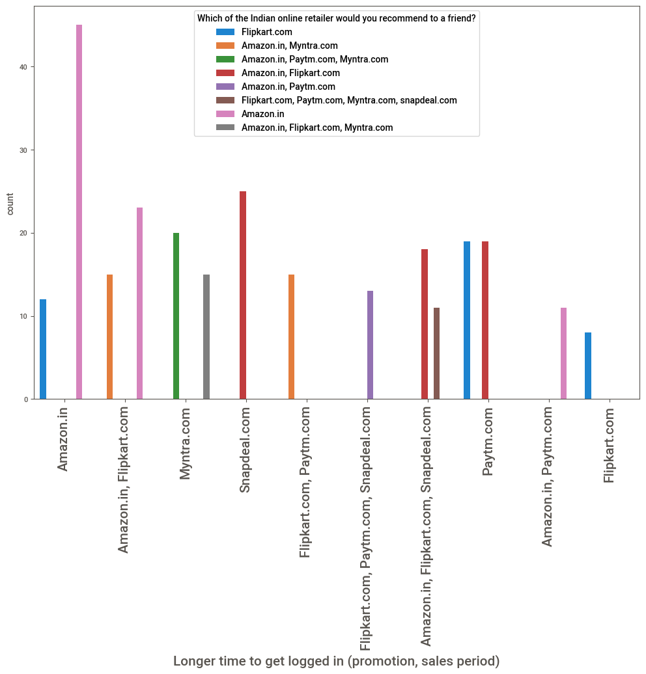
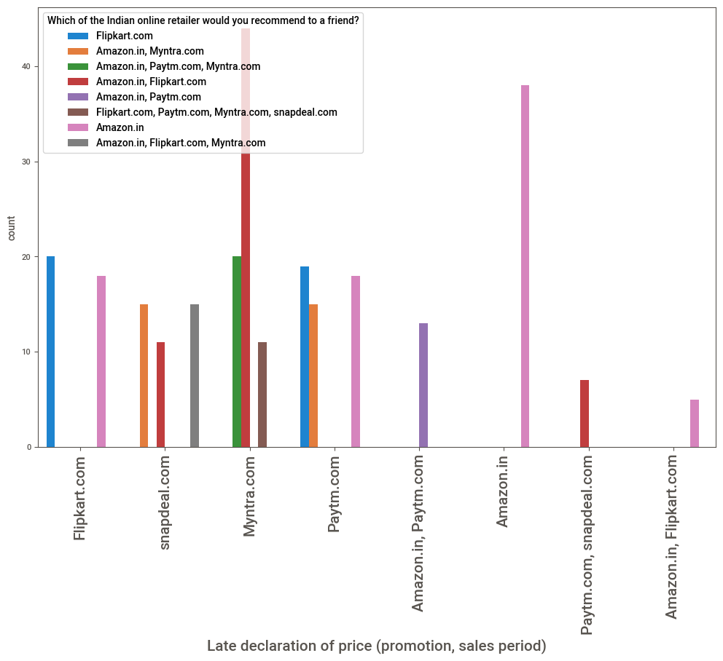
Customer’s Recommendation for which site is preference

Slide 26
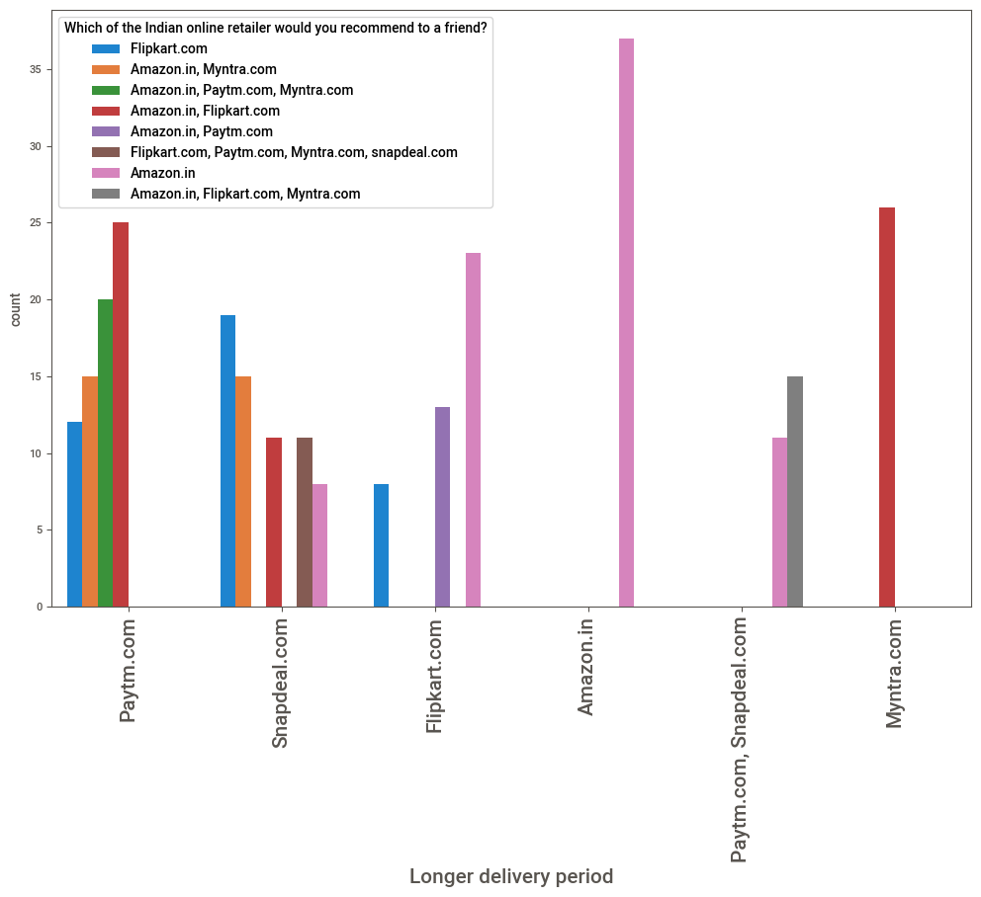

Slide 27
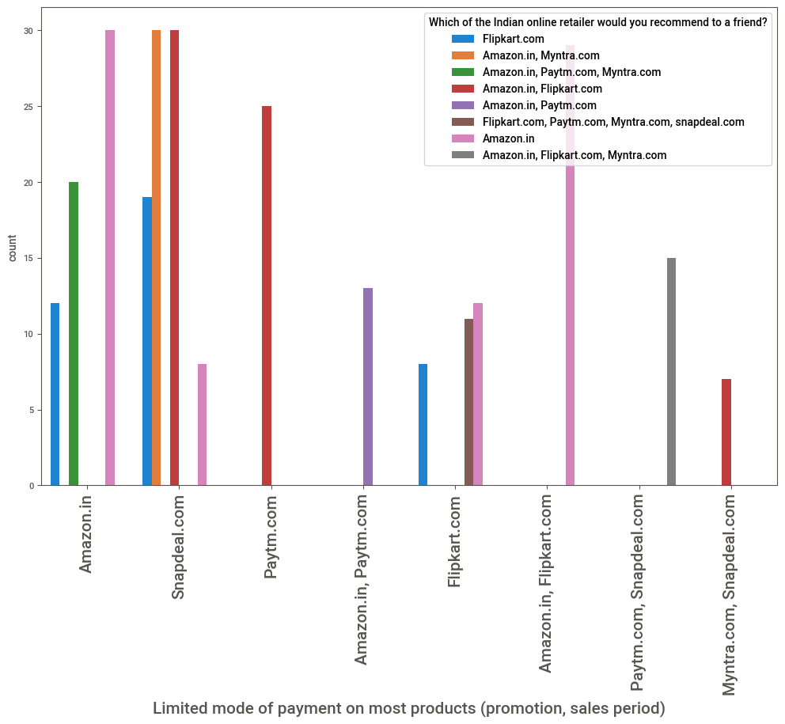

Slide 28
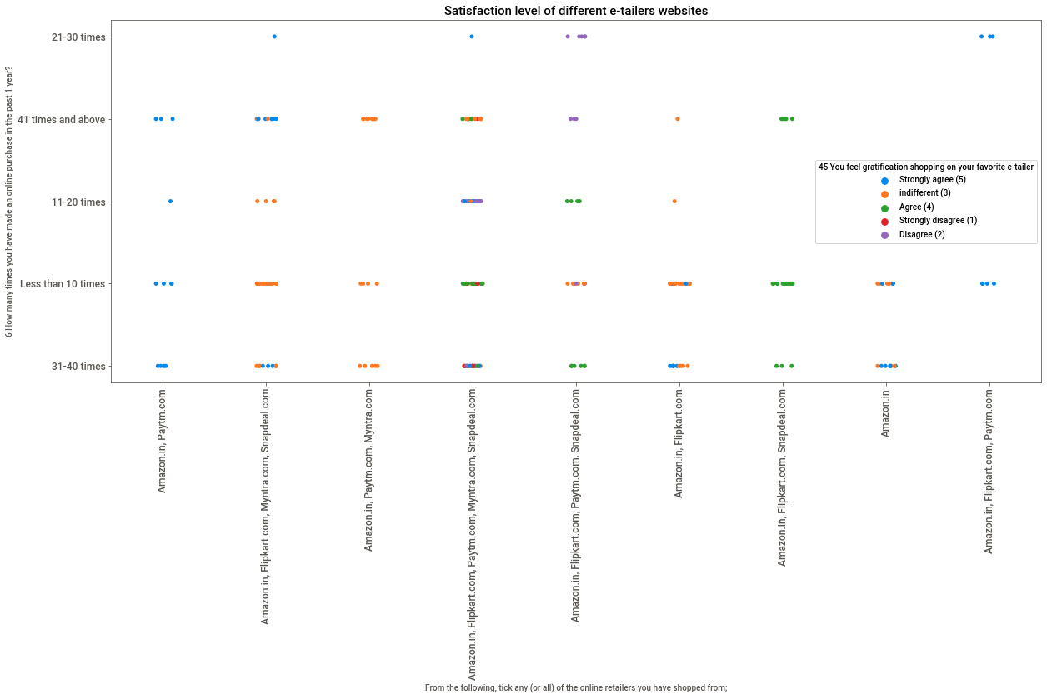

Slide 29
Conclusion
Key Findings Features and Conclusions of the Study
Scores | Features
75.754028 | Why did you abandon the “Bag”, “Shopping Ca...
59.810983 | Loading and processing speed
59.253569 | Shopping on the website gives you the sense...
57.171099 | What browser do you run on your device to a...
55.301526 | Change in website/Application design
54.24576 | Visual appealing web-page layout
53.269266 | Limited mode of payment on most products (prom...
48.222655 | Longer time to get logged in (promotion, sales...
48.130643 | Longer time in displaying graphics and photos ...
47.605973 | Wild variety of product on offer
Above features are important to know about customer purchase behaviours and retention to Online Shopping. From the observation we conclude that Amazon and Flipkart both are most reliable and Trustworthiness e-commerce websites for shopping and customers mostly use of this

Slide 30
Benefits and Drawback of E-retailers
Benefits:
Wide range of products
Saves money
Saves time
Exchange benefits
Adequate Information
Convenience
Drawbacks:
Delay in delivery. ...
Lack of significant discounts in online shops. ...
Lack of touch and feel of merchandise in online shopping. ...
Lack of interactivity in online shopping. ...
Lack of shopping experience. ...
Lack of close examination in online shopping. ...
Frauds in online shopping.

Slide 31
Device and Library Use
Hardware and Software Requirements and Tools Used
Device name: HP Pavilion
Processor: AMD Ryzen 5 3550H with Radeon Vega Mobile Gfx 2.10 GHz
RAM: 8.00 GB
System type: 64-bit operating system, x64-based processor
Edition: Windows 10 Home Single Language
Version: 21H1
OS build: 19043.1288
Jupyter NoteBooks Version : 6.4.3
Python3 vesrion : 3.8.

Slide 32
Device and Library Use
Required Libraries Used For Dataset
import pandas as pd
import numpy as np
import matplotlib.pyplot as plt
%matplotlib inline
import seaborn as sns
import pandas_profiling as ProfileReport
import IPython.display as display
import warnings
warnings.filterwarnings('ignore')
from sklearn.preprocessing import OrdinalEncoder,MinMaxScaler
from sklearn.feature_selection import SelectKBest,chi2

Slide 33
References
This includes mentioning of all the references, research papers, data sources, professionals and other resources that helped you and guided you in completion of the project.
https://www.kaggle.com/harshjain123/feature-engineering-from-scratch using this website for Features selection, Missing value handling, Assumption, Statistical analysis.
https://www.analyticssteps.com/blogs/introduction-statistical-data-analysis used this website for statistics theory concept and study about data set.
https://www.codespeedy.com/p-value-in-machine-learning-python/ use for statistics tools like hypothesis test, p- values for features selection and features analysis.
Use Some Googles, YouTube channels and Stack overflow for coding.

